Slide 1
Neural Networks: Optimization Variants
CS 760: Machine Learning
Spring 2019
Mark Craven and David Page

Slide 2
Goals for the Lecture
You should understand the following concepts:
momentum
Nesterov momentum
adaptive step size
AdaGrad
RMSProp
Adam
Thanks to Yujia Bao for contributions to these lecture notes

Slide 3
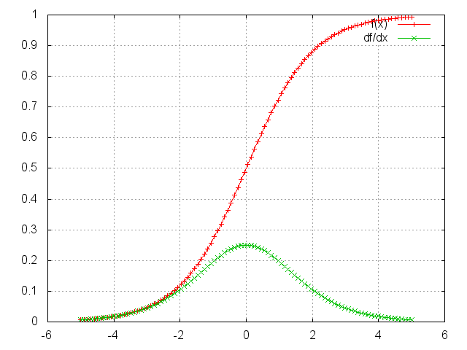
Initializing weights
Weights should be initialized to
small values so that e.g. with sigmoids, activations are in the range where the derivative is large (learning will be quicker)
random values to ensure symmetry breaking (i.e. if all weights are the same, the hidden units will all represent the same thing)
typical initial weight range [-0.01, 0.01]

Slide 4
Setting the learning rate
convergence depends on having an appropriate learning rate
Error
η too small (error goes down
a little)
η too large (error goes up)

Slide 5
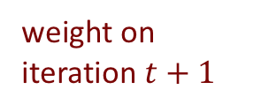
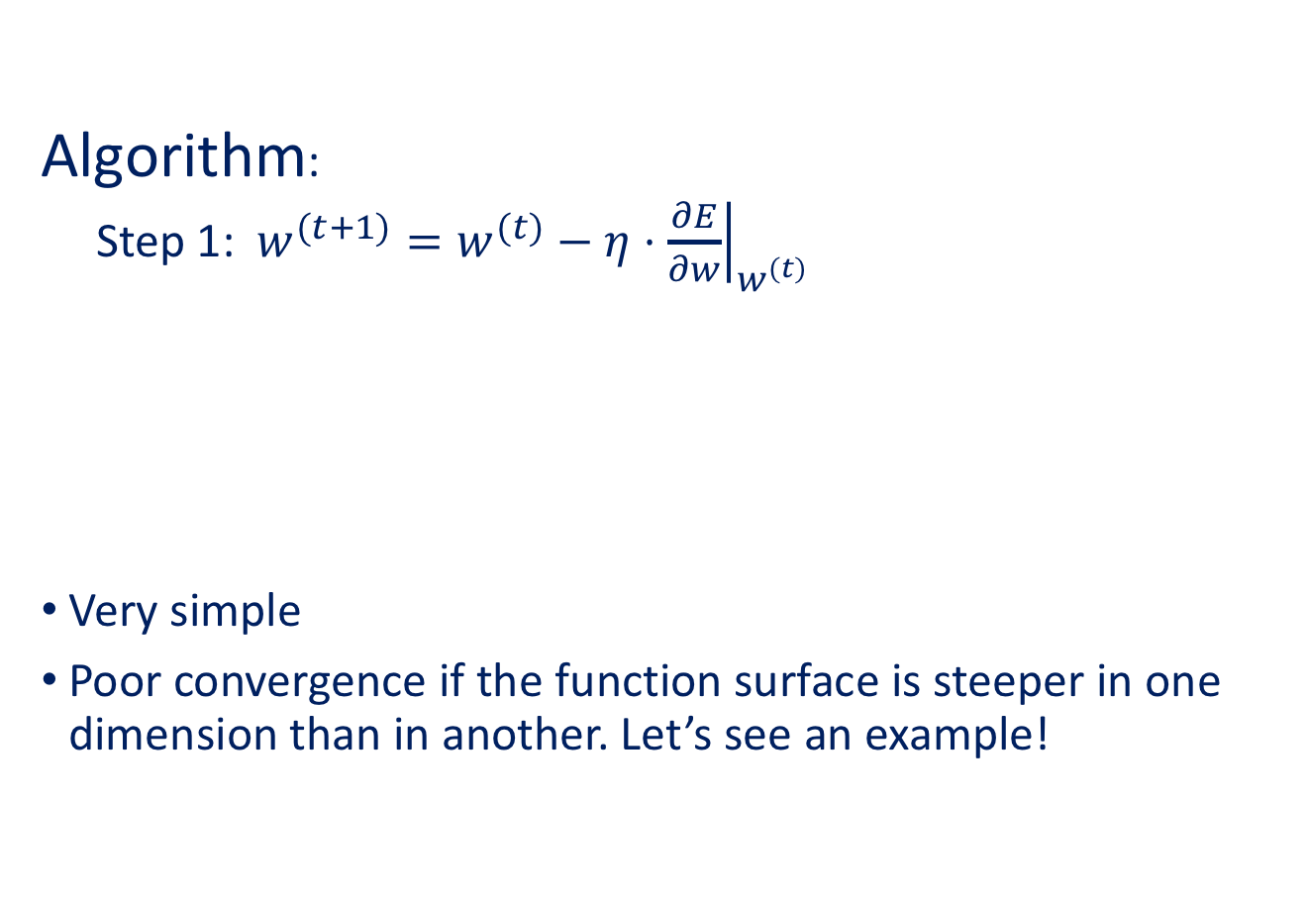
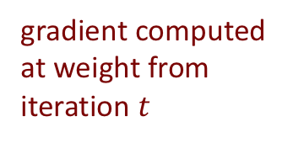
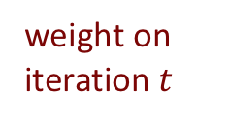
Steepest Descent (a.k.a Gradient Descent)
Algorithm:
Step 1: $w^{(t+1)}=w^{(t)}−η⋅{\left.\frac{∂E}{∂w}\right|}_{w^{(t)}}$
Very simple
Poor convergence if the function surface is steeper in one dimension than in another. Let’s see an example!
weight on iteration $t+1$
weight on iteration $t$
gradient computed at weight from iteration $t$

Slide 6
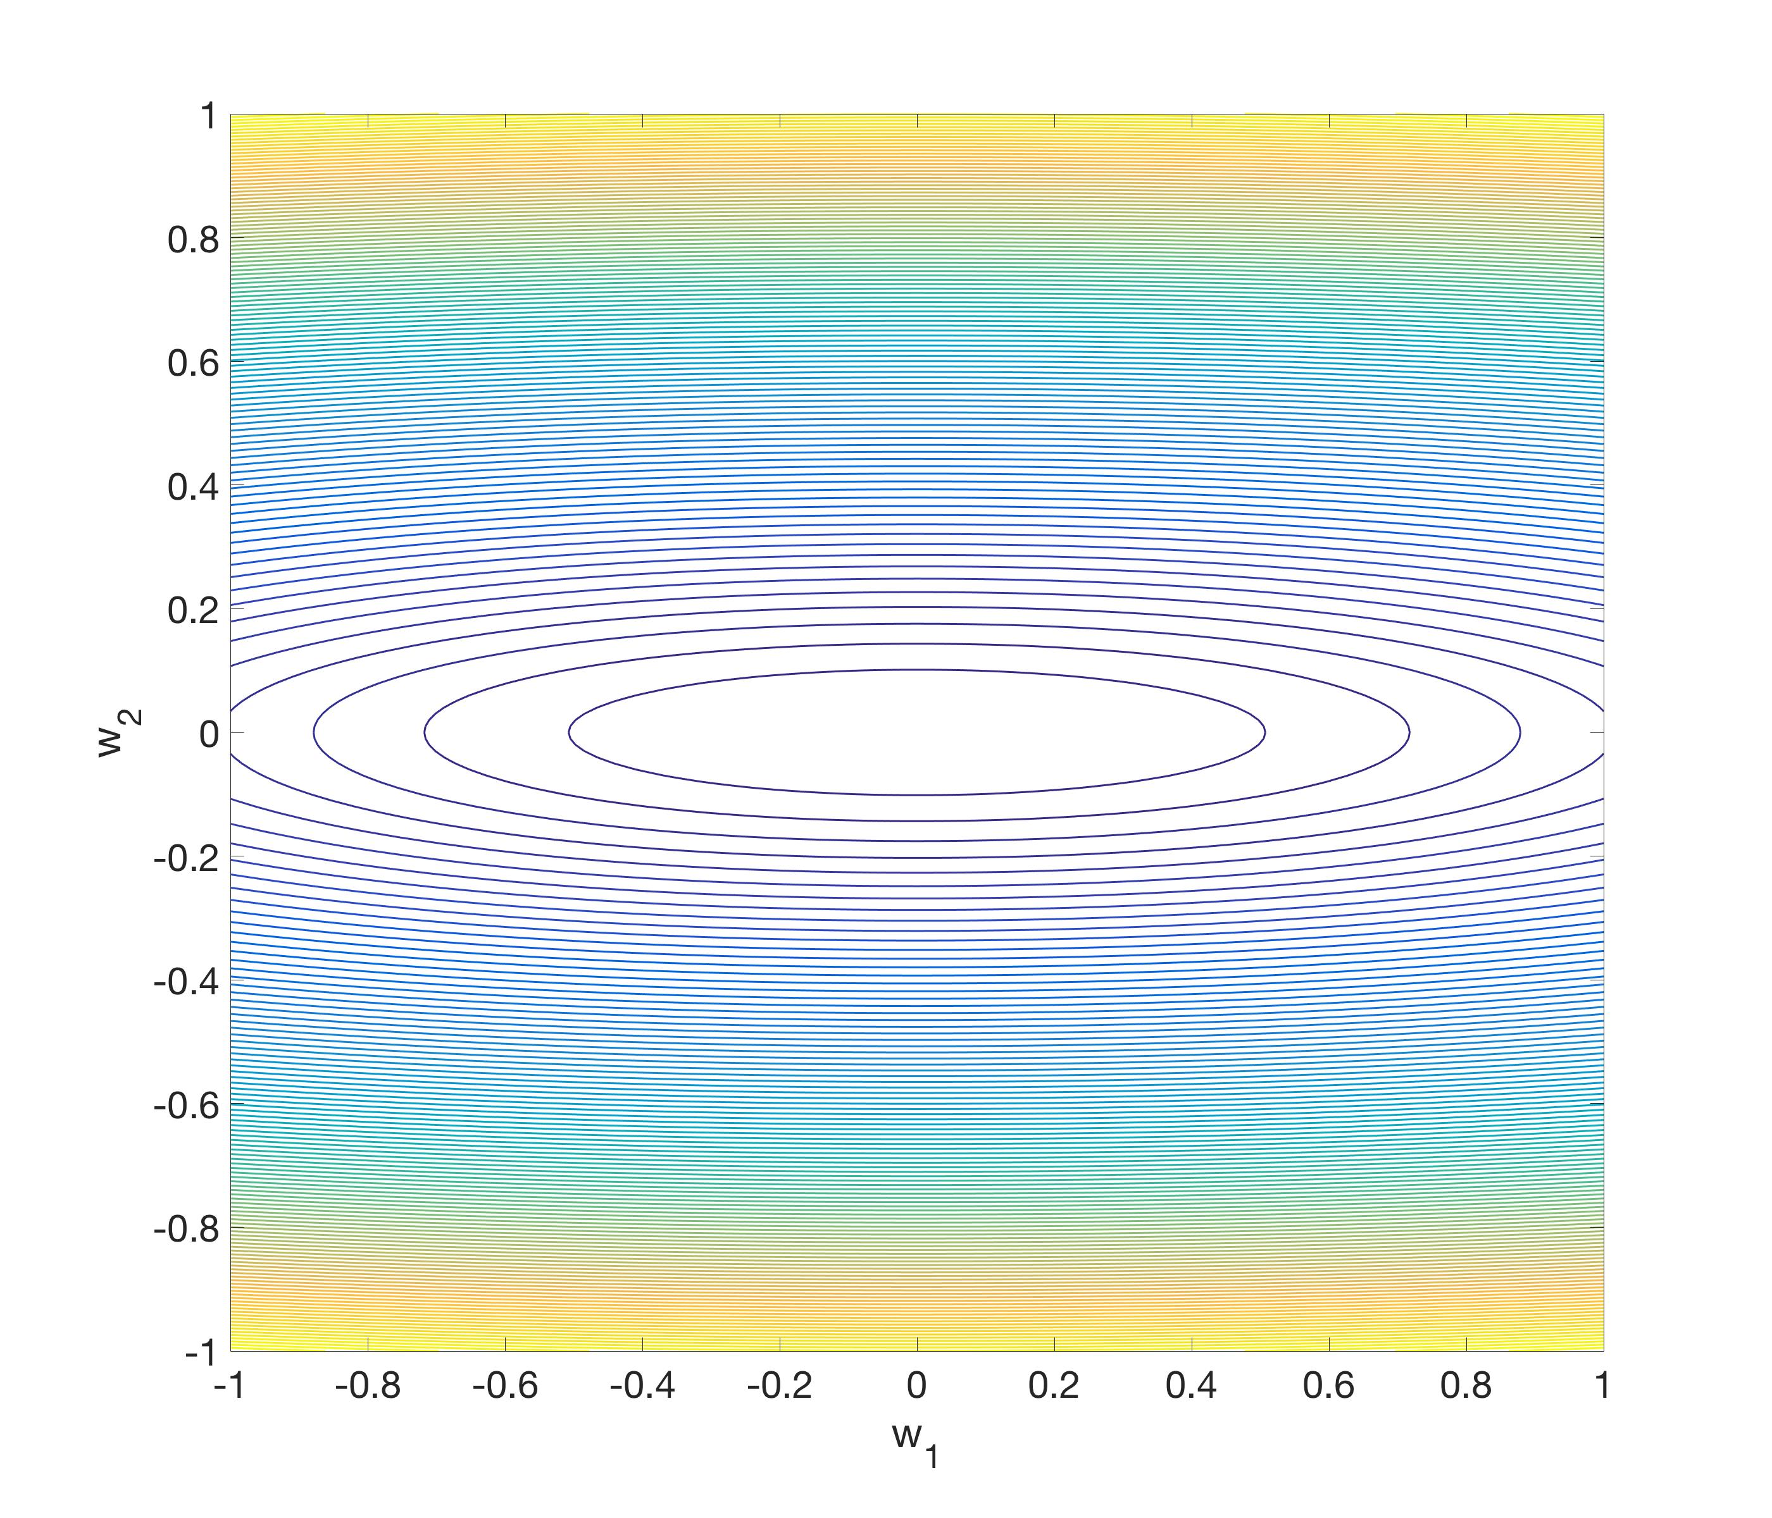
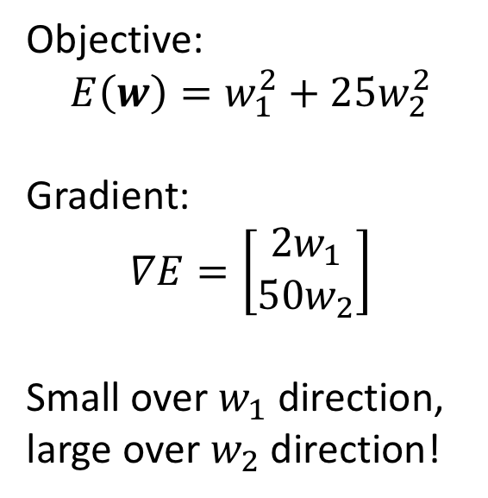
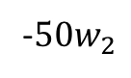
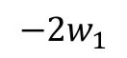
Steepest Descent
Objective:
$$E\left(w\right)=w_{1}^{2}+25w_{2}^{2}$$
Gradient:
$$∇E=\left[\begin{matrix}2w_{1} \\ 50w_{2}\end{matrix}\right]$$
Small over $w_{1}$ direction,
large over $w_{2}$ direction!
-$50w_{2}$
$$−2w_{1}$$

Slide 7
Steepest Descent
Zigzag behavior!
Move very slowly on the flat direction, oscillate on the steep direction.

Slide 8
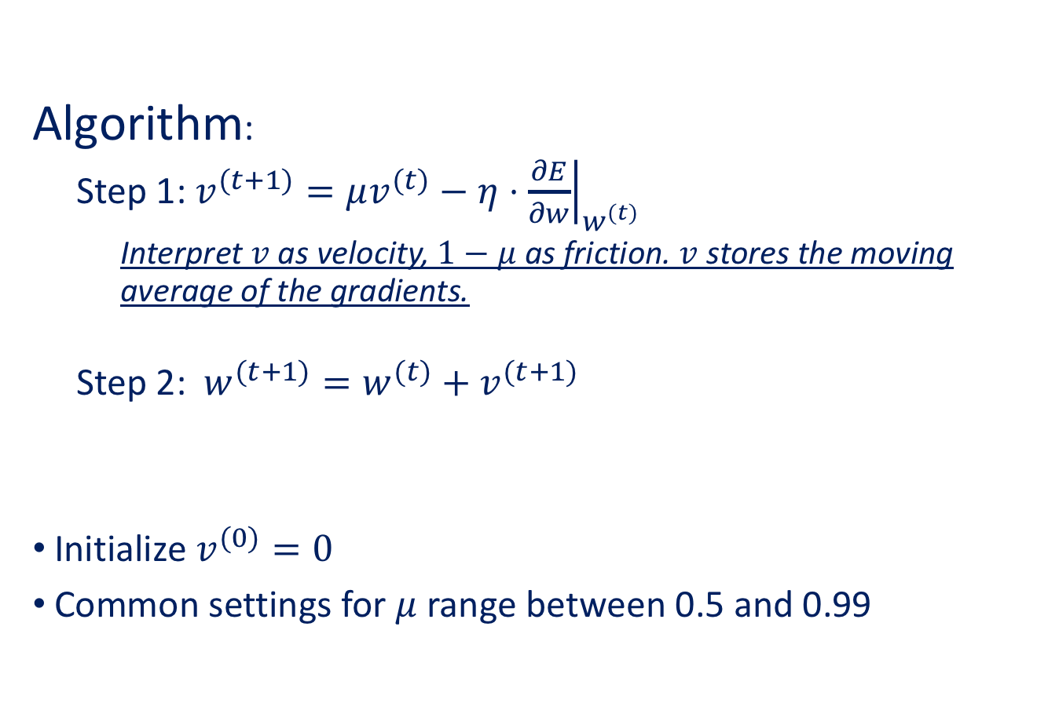
Momentum
Algorithm:
Step 1: $v^{(t+1)}=μv^{(t)}−η⋅{\left.\frac{∂E}{∂w}\right|}_{w^{(t)}}$
Interpret $v$ as velocity, $1−μ$ as friction. $v$ stores the moving average of the gradients.
Step 2: $w^{(t+1)}=w^{(t)}+v^{(t+1)}$
Initialize $v^{(0)}=0$
Common settings for $μ$ range between 0.5 and 0.99

Slide 9
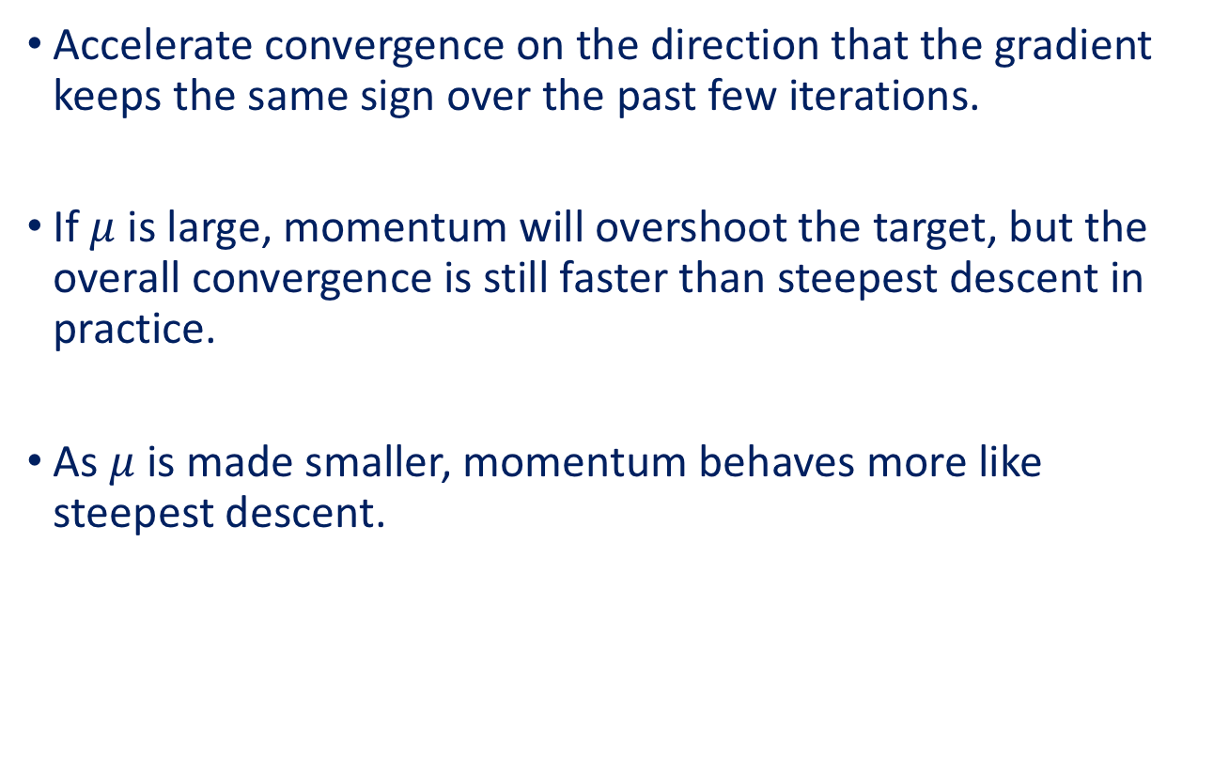
Momentum
Accelerate convergence on the direction that the gradient keeps the same sign over the past few iterations.
If $μ$ is large, momentum will overshoot the target, but the overall convergence is still faster than steepest descent in practice.
As $μ$ is made smaller, momentum behaves more like steepest descent.

Slide 10
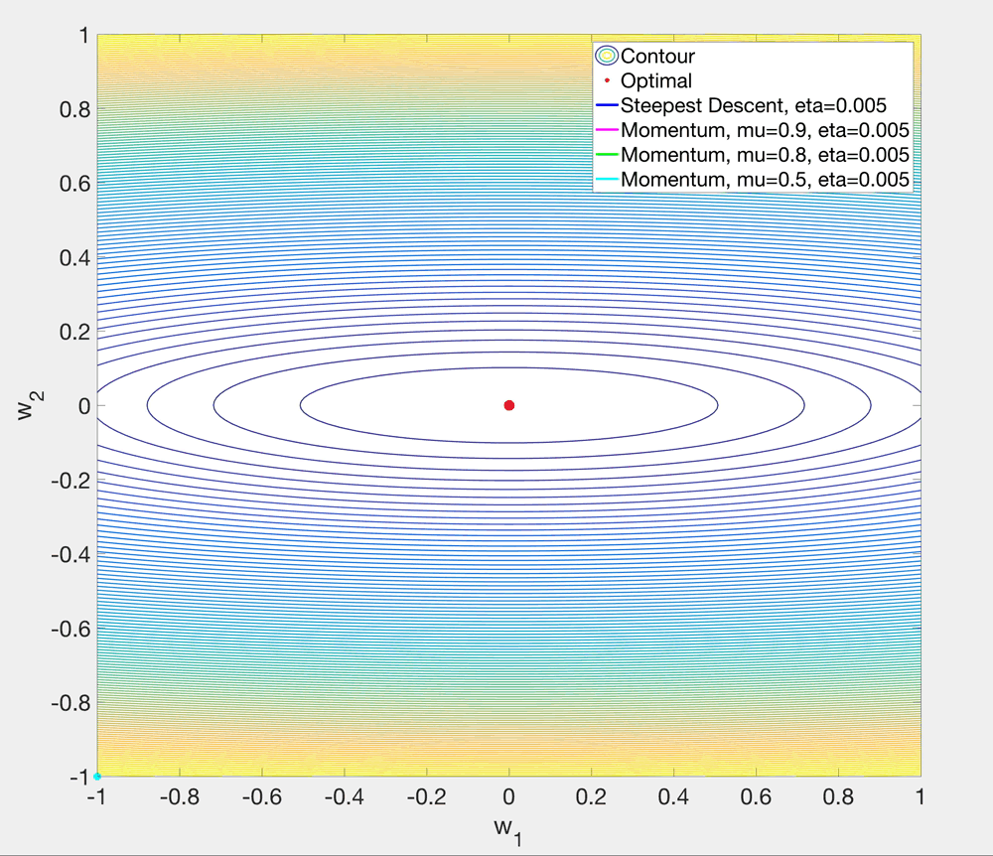

Slide 11
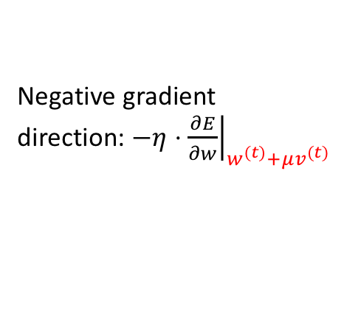
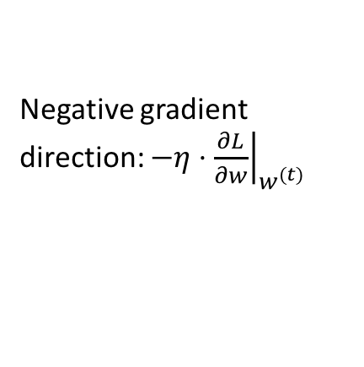
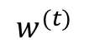
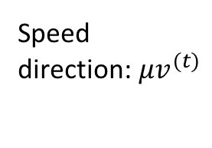
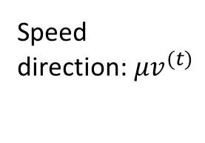
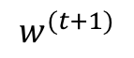
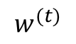
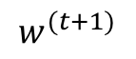
Nesterov Accelerated Gradient
Momentum
Nesterov Accelerated Gradient
$$w^{(t+1)}$$
Negative gradient
direction: $−η⋅{\left.\frac{∂E}{∂w}\right|}_{w^{(t)}+μv^{(t)}}$
Speed
direction:$μv^{(t)}$
Speed
direction:$μv^{(t)}$
$$w^{(t+1)}$$
Actual update
Actual update
$$w^{(t)}$$
$$w^{(t)}$$
Negative gradient
direction: $−η⋅{\left.\frac{∂L}{∂w}\right|}_{w^{(t)}}$

Slide 12
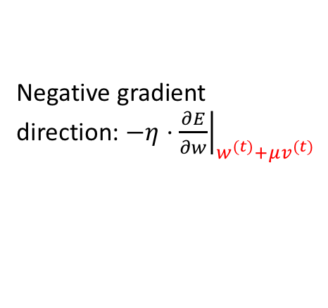
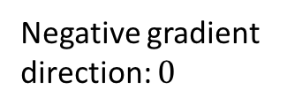
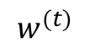
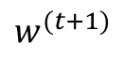
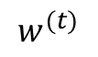
An example
Suppose $w^{(t)}$ is already optimal, but $v^{(t)}≠0$.
Momentum
Nesterov Accelerated Gradient
$$w^{(t+1)}$$
Negative gradient
direction: $−η⋅{\left.\frac{∂E}{∂w}\right|}_{w^{(t)}+μv^{(t)}}$
Speed
direction:$μv^{(t)}$
Speed
direction:$μv^{(t)}$
Actual update
$$w^{(t+1)}$$
Actual update
$$w^{(t)}$$
$$w^{(t)}$$
Negative gradient
direction: $0$
A look-ahead approach

Slide 13
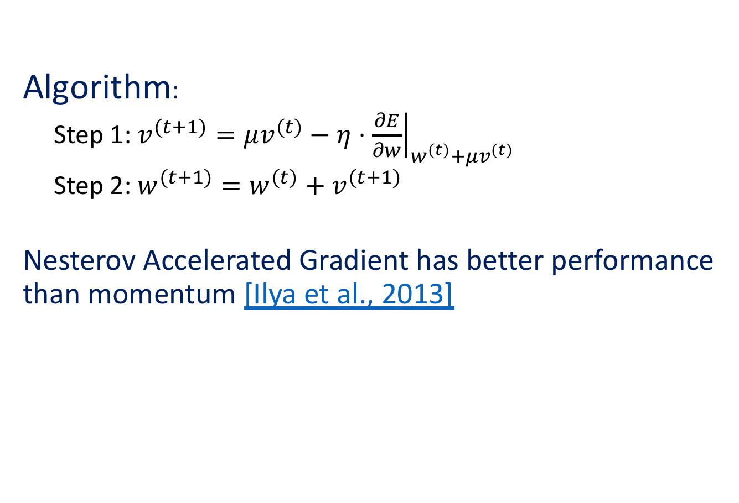
Nesterov Accelerated Gradient
Algorithm:
Step 1: $v^{(t+1)}=μv^{(t)}−η⋅{\left.\frac{∂E}{∂w}\right|}_{w^{(t)}+μv^{(t)}}$
Step 2: $w^{(t+1)}=w^{(t)}+v^{(t+1)}$
Nesterov Accelerated Gradient has better performance than momentum [Ilya et al., 2013]

Slide 14
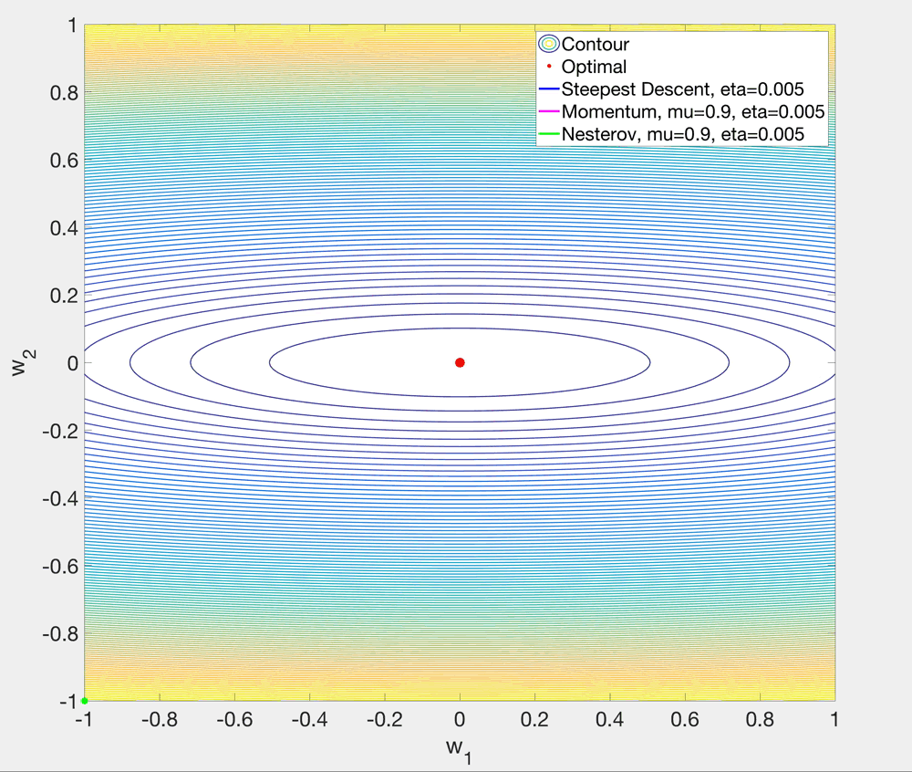

Slide 15
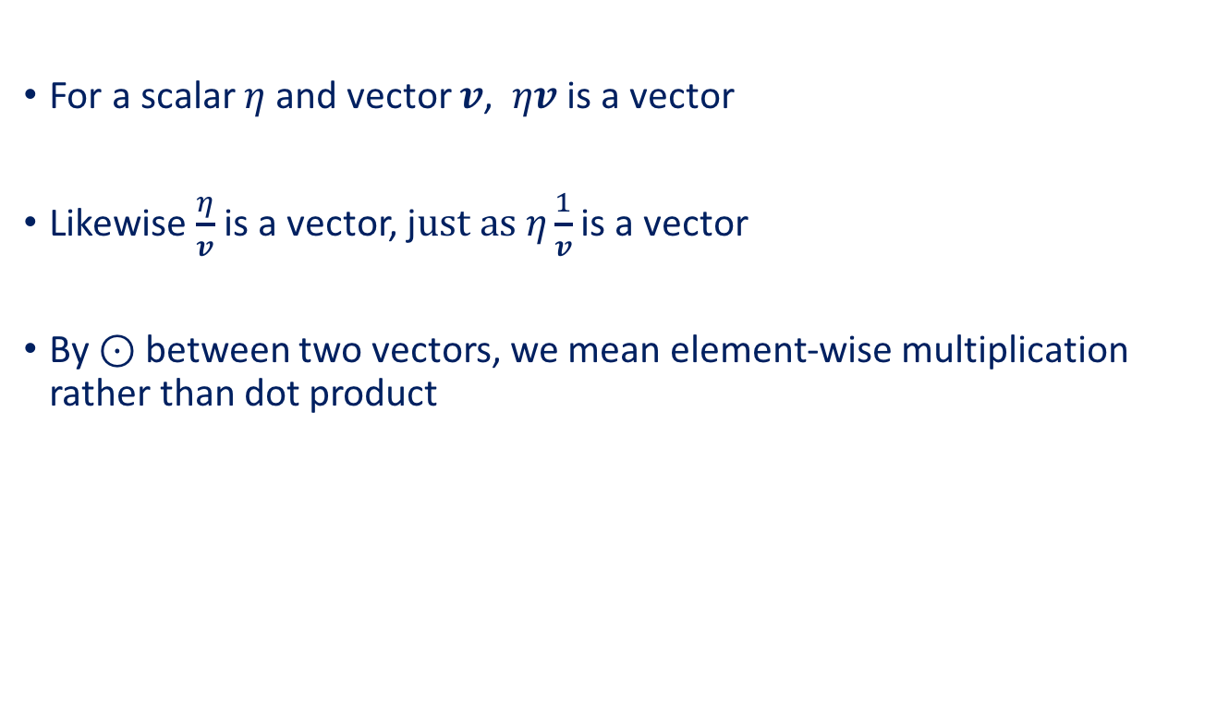
Some notes on notation in this lecture
For a scalar $η$and vector $v$, $ηv$ is a vector
Likewise $\frac{η}{v}$ is a vector, j$ust as η\frac{1}{v}$ is a vector
By $⊙$ between two vectors, we mean element-wise multiplication rather than dot product

Slide 16
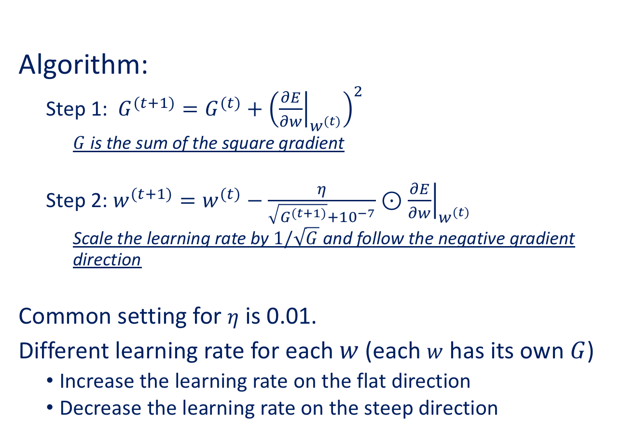
AdaGrad (Adaptive Gradient) [Duchi et al., 2011]
Algorithm:
Step 1: $G^{(t+1)}=G^{(t)}+{\left({\left.\frac{∂E}{∂w}\right|}_{w^{(t)}}\right)}^{2}$
$G$ is the sum of the square gradient
Step 2: $w^{(t+1)}=w^{(t)}−\frac{η}{\sqrt{G^{(t+1)}}+{10}^{−7}}⊙{\left.\frac{∂E}{∂w}\right|}_{w^{(t)}}$
Scale the learning rate by $1/\sqrt{G}$ and follow the negative gradient direction
Common setting for $η$ is 0.01.
Different learning rate for each $w$ (each $w$ has its own $G$)
Increase the learning rate on the flat direction
Decrease the learning rate on the steep direction

Slide 17
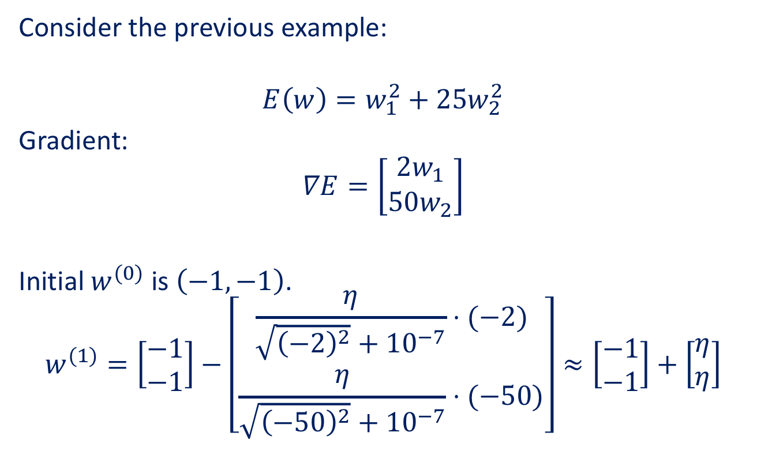
AdaGrad (Adaptive Gradient)
Consider the previous example:
$$E\left(w\right)=w_{1}^{2}+25w_{2}^{2}$$
Gradient:
$$∇E=\left[\begin{matrix}2w_{1} \\ 50w_{2}\end{matrix}\right]$$
Initial $w^{(0)}$ is $\left(−1,−1\right)$.
$$w^{(1)}=\left[\begin{matrix}−1 \\ −1\end{matrix}\right]−\left[\begin{matrix}\frac{η}{\sqrt{{\left(−2\right)}^{2}}+{10}^{−7}}⋅(−2) \\ \frac{η}{\sqrt{{\left(−50\right)}^{2}}+{10}^{−7}}⋅(−50)\end{matrix}\right]≈\left[\begin{matrix}−1 \\ −1\end{matrix}\right]+\left[\begin{matrix}η \\ η\end{matrix}\right]$$
Will follow the diagonal direction!

Slide 18
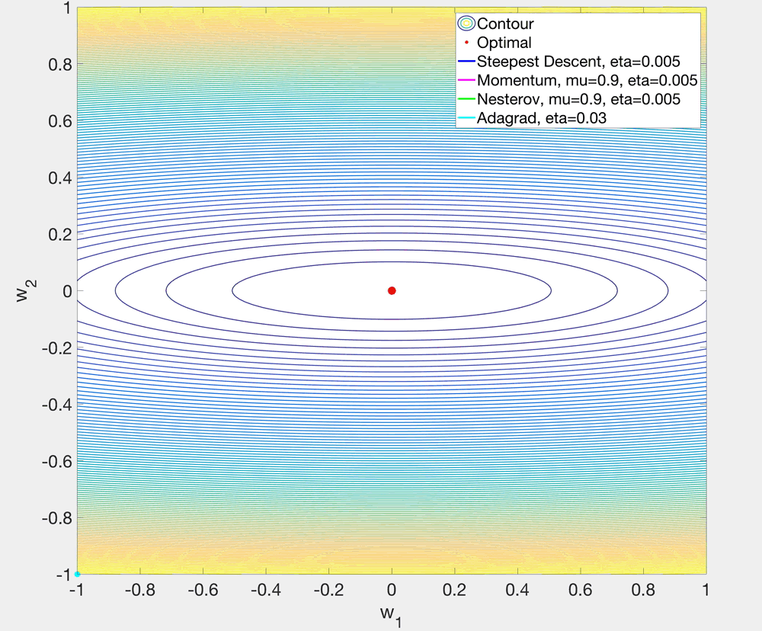

Slide 19
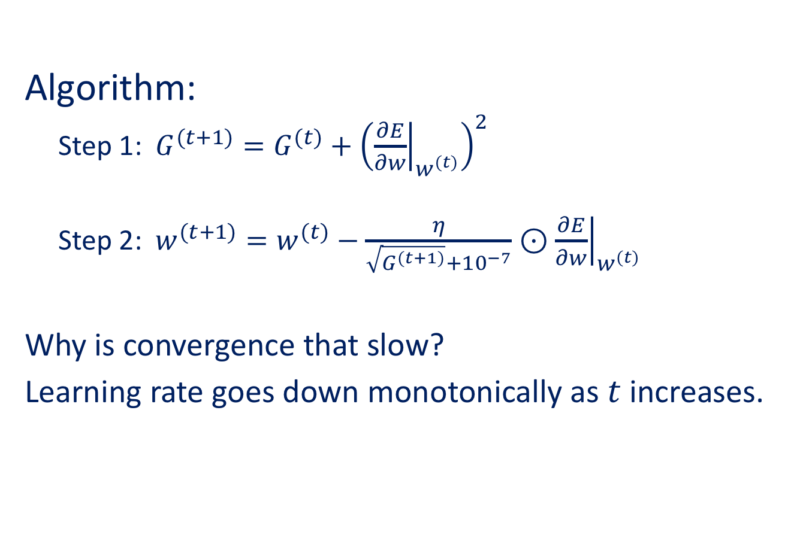
AdaGrad (Adaptive Gradient)
Algorithm:
Step 1: $G^{(t+1)}=G^{(t)}+{\left({\left.\frac{∂E}{∂w}\right|}_{w^{(t)}}\right)}^{2}$
Step 2: $w^{(t+1)}=w^{(t)}−\frac{η}{\sqrt{G^{(t+1)}}+{10}^{−7}}⊙{\left.\frac{∂E}{∂w}\right|}_{w^{(t)}}$
Why is convergence that slow?
Learning rate goes down monotonically as $t$ increases.

Slide 20
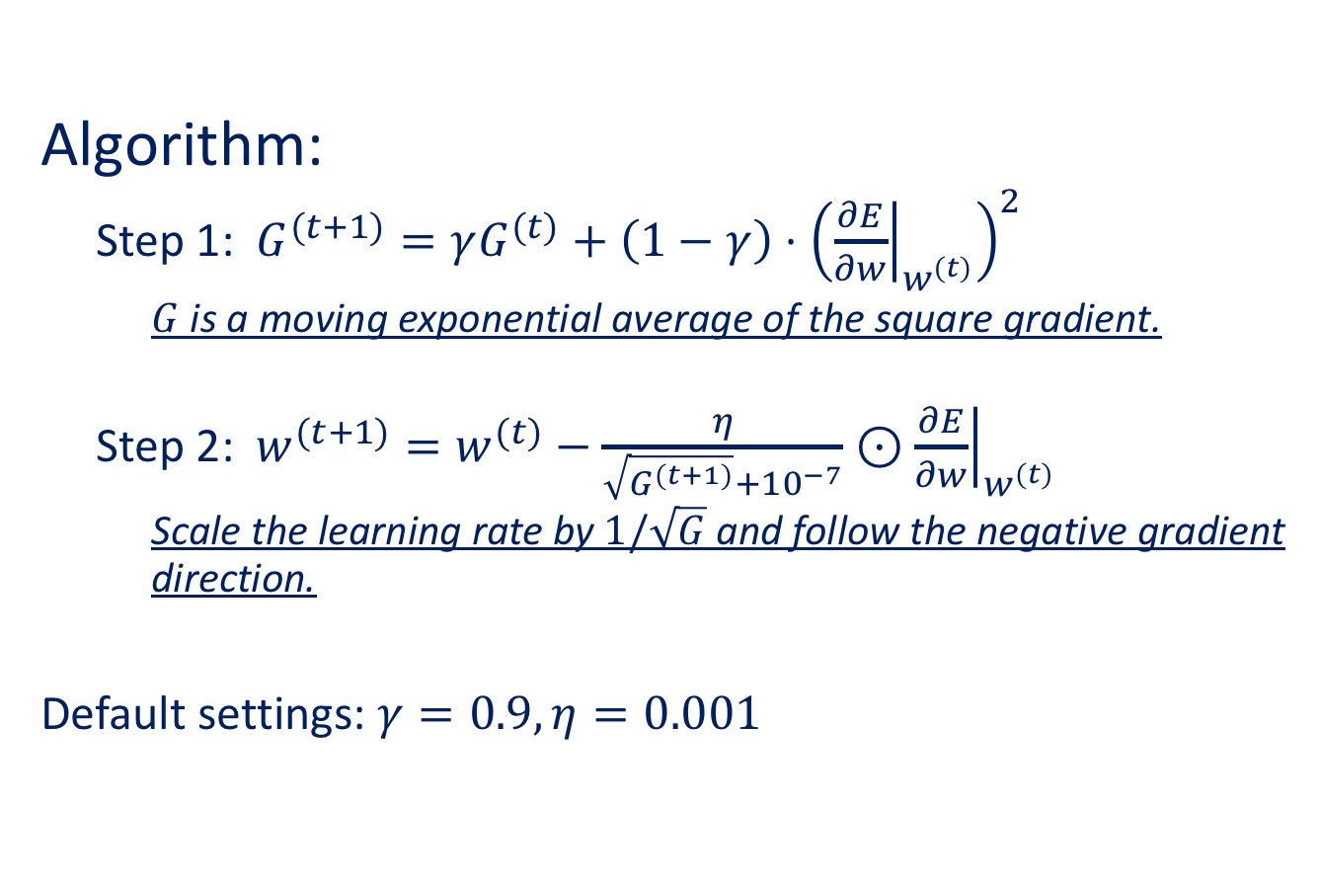
RMSProp (Root Mean Square Propagation) [Tieleman & Hinton, 2012]
Algorithm:
Step 1: $G^{(t+1)}=γG^{(t)}+\left(1−γ\right)⋅{\left({\left.\frac{∂E}{∂w}\right|}_{w^{(t)}}\right)}^{2}$
$G$ is a moving exponential average of the square gradient.
Step 2: $w^{(t+1)}=w^{(t)}−\frac{η}{\sqrt{G^{(t+1)}}+{10}^{−7}}⊙{\left.\frac{∂E}{∂w}\right|}_{w^{(t)}}$
Scale the learning rate by $1/\sqrt{G}$ and follow the negative gradient direction.
Default settings: $γ=0.9, η=0.001$

Slide 21
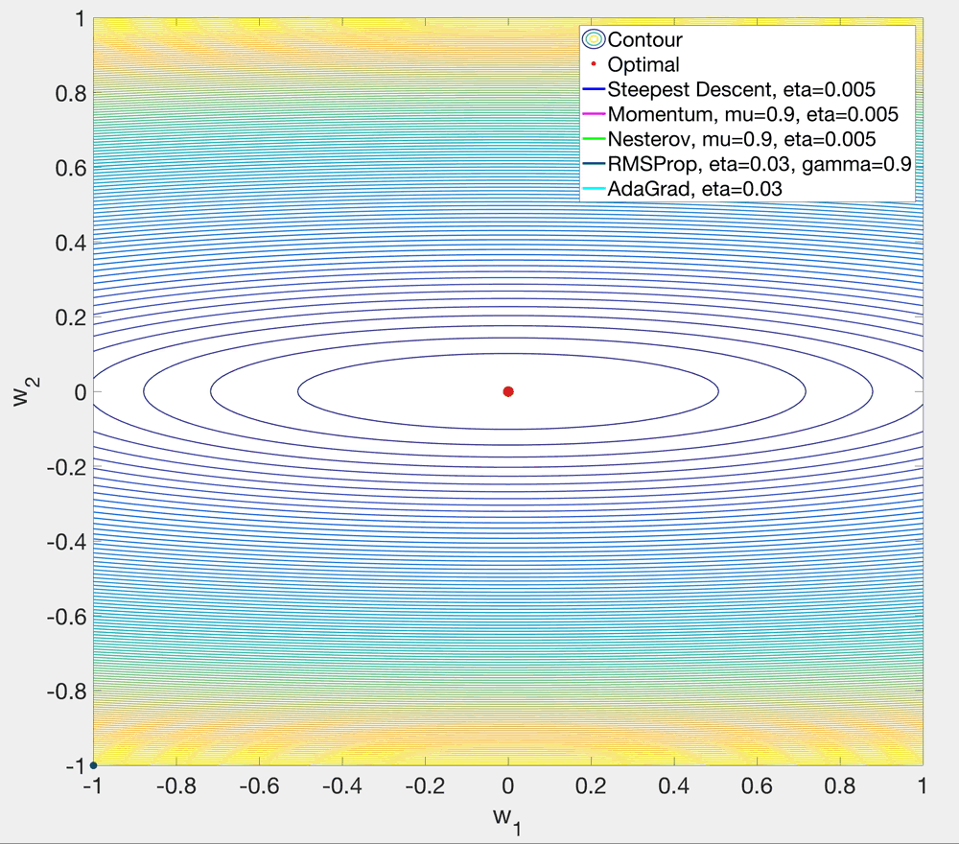

Slide 22
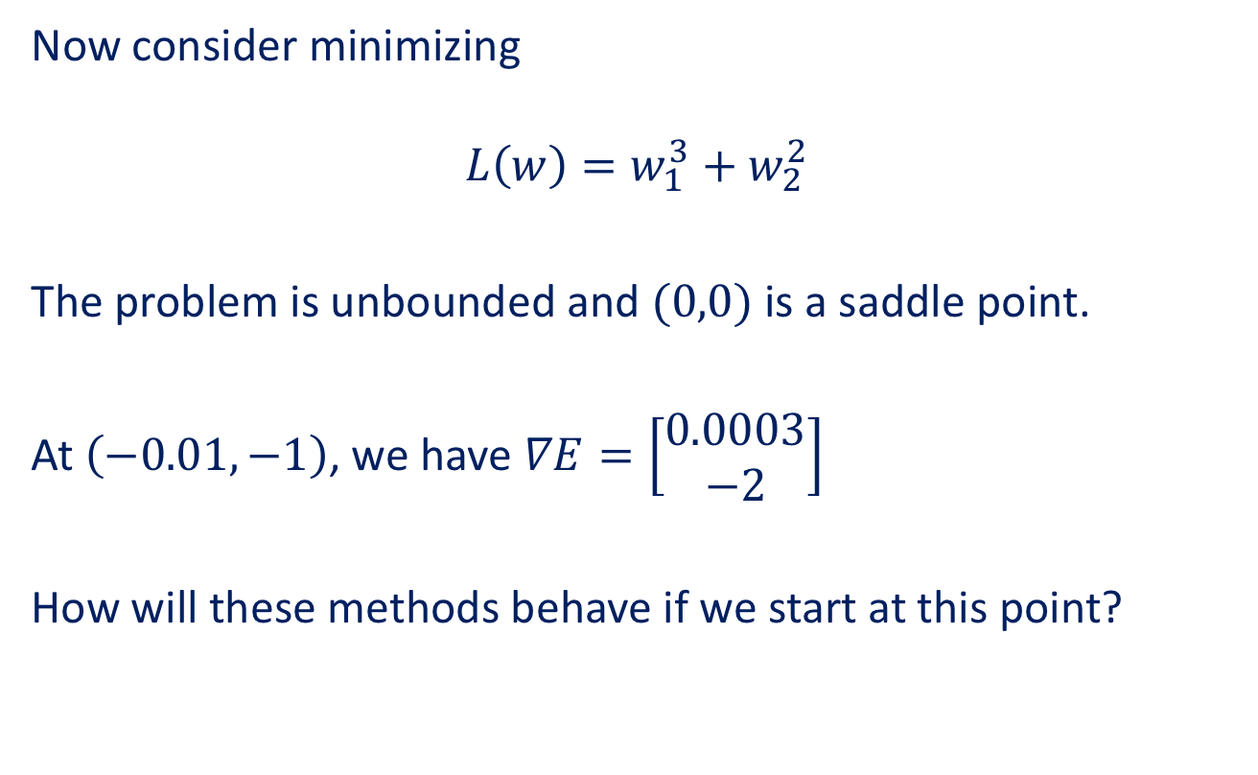
Another example (saddle point)
Now consider minimizing
$$L\left(w\right)=w_{1}^{3}+w_{2}^{2}$$
The problem is unbounded and $(0,0)$ is a saddle point.
At $\left(−0.01,−1\right)$, we have $∇E=\left[\begin{matrix}0.0003 \\ −2\end{matrix}\right]$
How will these methods behave if we start at this point?

Slide 23
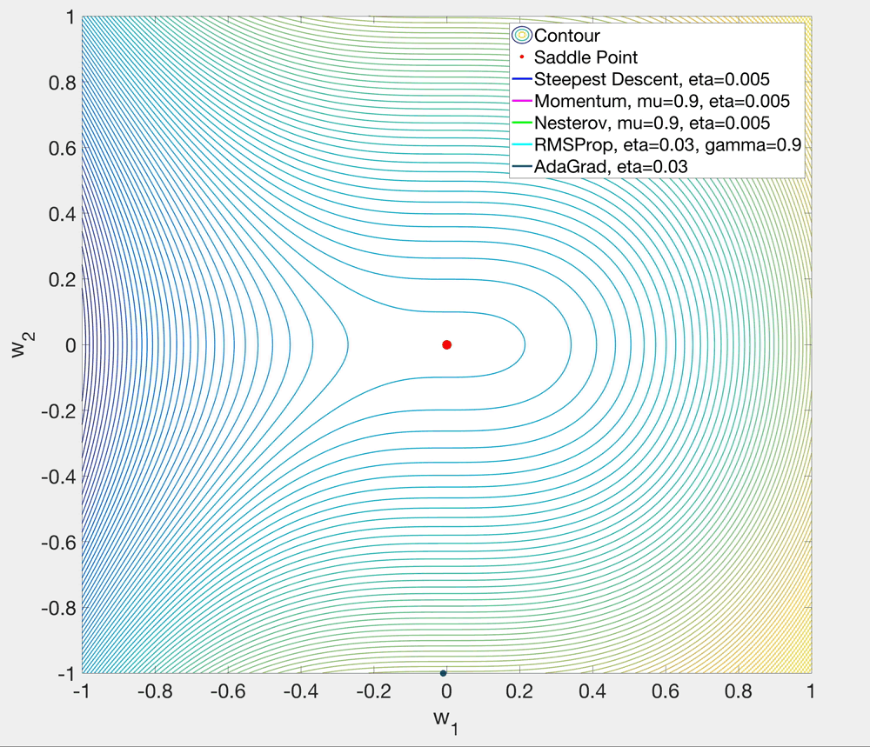

Slide 24
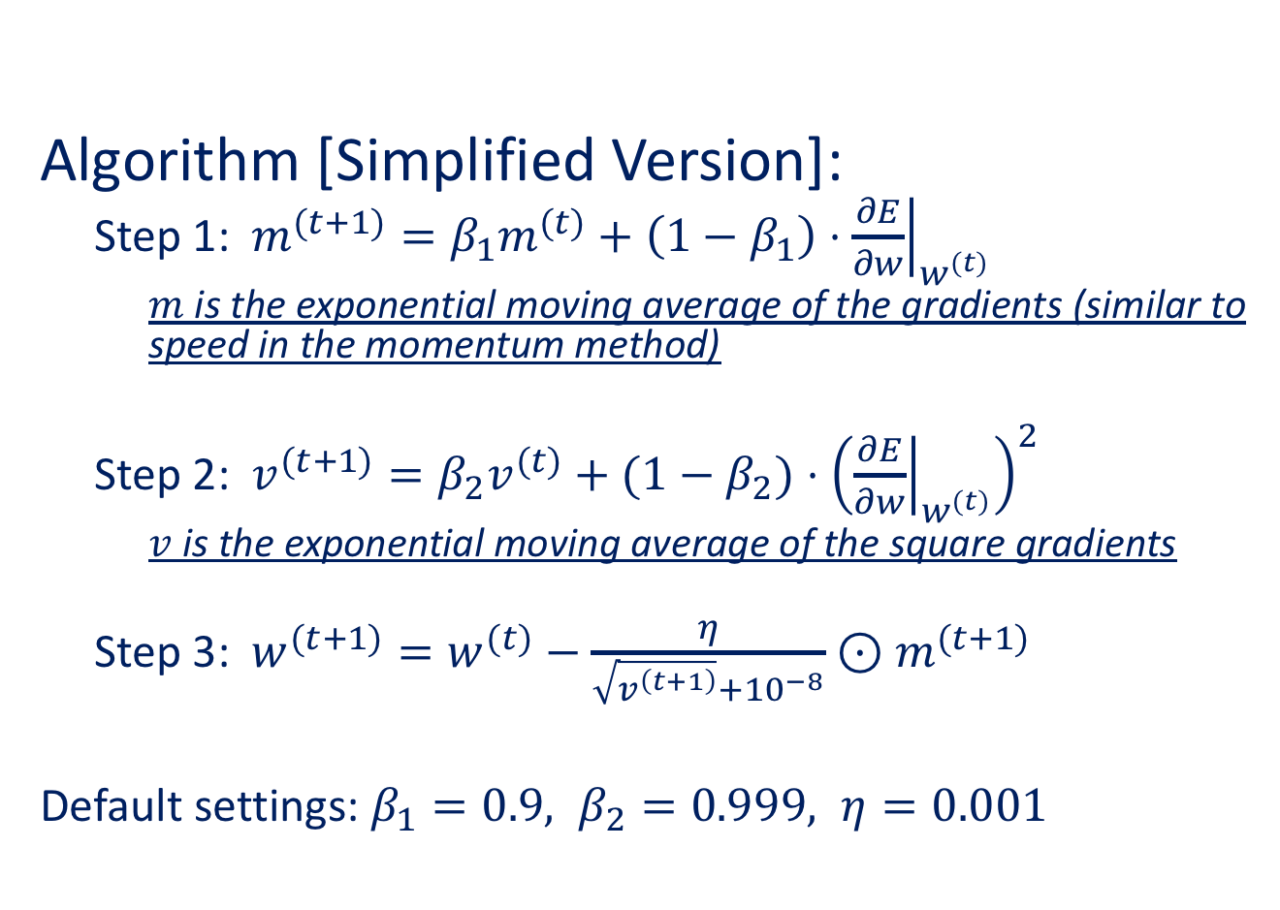
Adam (Adaptive Moment Estimation) [Kingma & Ba, 2015]
Algorithm [Simplified Version]:
Step 1: $m^{(t+1)}=β_{1}m^{(t)}+\left(1−β_{1}\right)⋅{\left.\frac{∂E}{∂w}\right|}_{w^{(t)}}$
$m$ is the exponential moving average of the gradients (similar to speed in the momentum method)
Step 2: $v^{(t+1)}=β_{2}v^{(t)}+(1−β_{2})$ $⋅{\left({\left.\frac{∂E}{∂w}\right|}_{w^{(t)}}\right)}^{2}$
$v$ is the exponential moving average of the square gradients
Step 3: $w^{(t+1)}=w^{(t)}−\frac{η}{\sqrt{v^{\left(t+1\right)}}+{10}^{−8}}⊙m^{(t+1)}$
Default settings: $β_{1}=0.9, β_{2}=0.999, η=0.001$

Slide 25
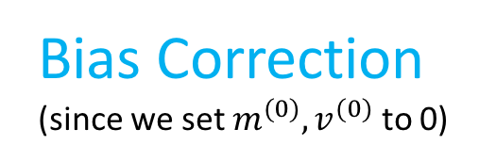
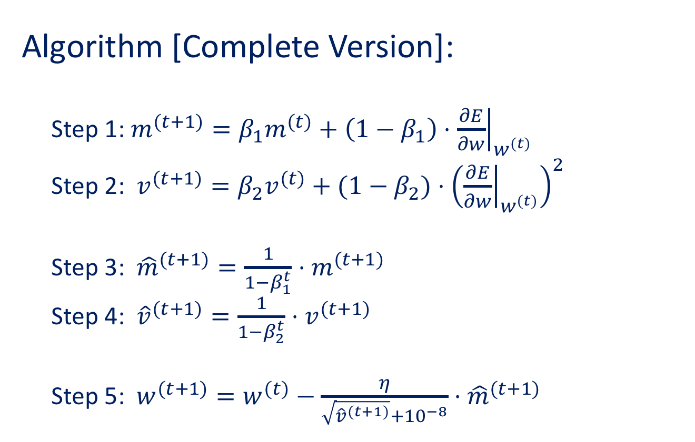
Adam (Adaptive Moment Estimation)
Algorithm [Complete Version]:
Step 1: $m^{(t+1)}=β_{1}m^{(t)}+\left(1−β_{1}\right)⋅{\left.\frac{∂E}{∂w}\right|}_{w^{(t)}}$
Step 2: $v^{(t+1)}=β_{2}v^{(t)}+(1−β_{2})$ $⋅{\left({\left.\frac{∂E}{∂w}\right|}_{w^{(t)}}\right)}^{2}$
Step 3: ${\hat{m}}^{(t+1)}=\frac{1}{1−β_{1}^{t}}⋅m^{(t+1)}$
Step 4: ${\hat{v}}^{(t+1)}=\frac{1}{1−β_{2}^{t}}⋅v^{(t+1)}$
Step 5: $w^{(t+1)}=w^{(t)}−\frac{η}{\sqrt{{\hat{v}}^{(t+1)}}+{10}^{−8}}⋅{\hat{m}}^{(t+1)}$
Bias Correction (since we set $m^{(0)},v^{(0)}$ to 0)

Slide 26
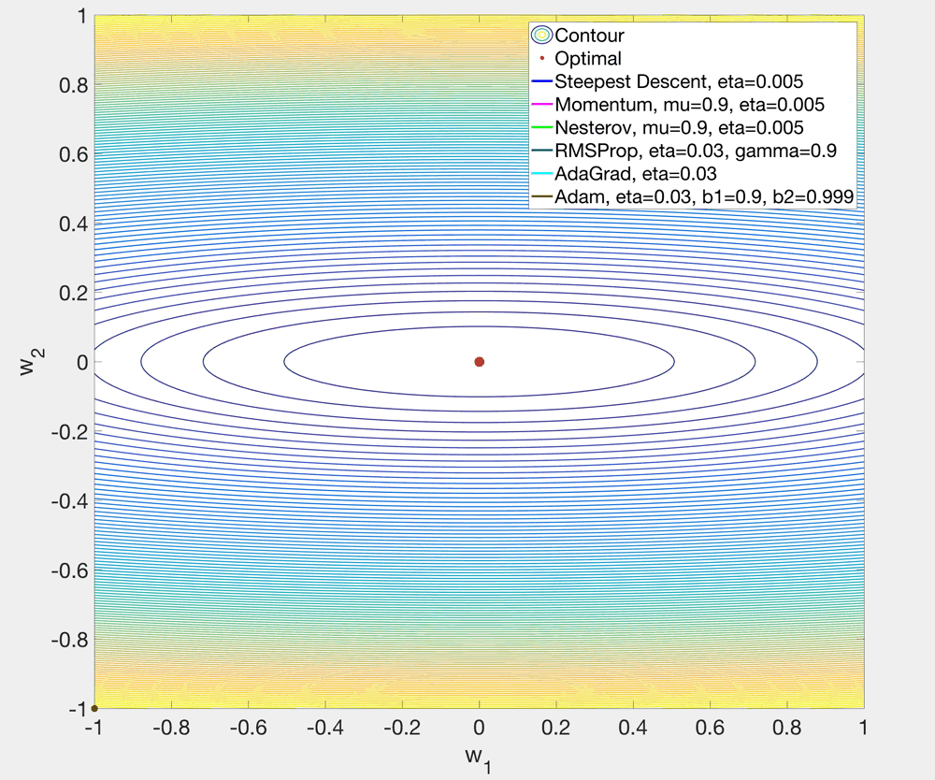

Slide 27
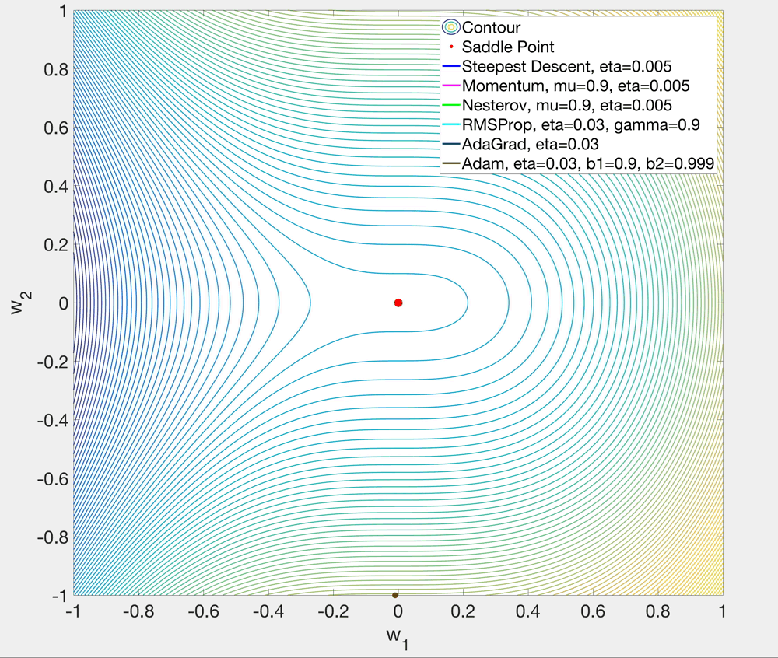

Slide 28
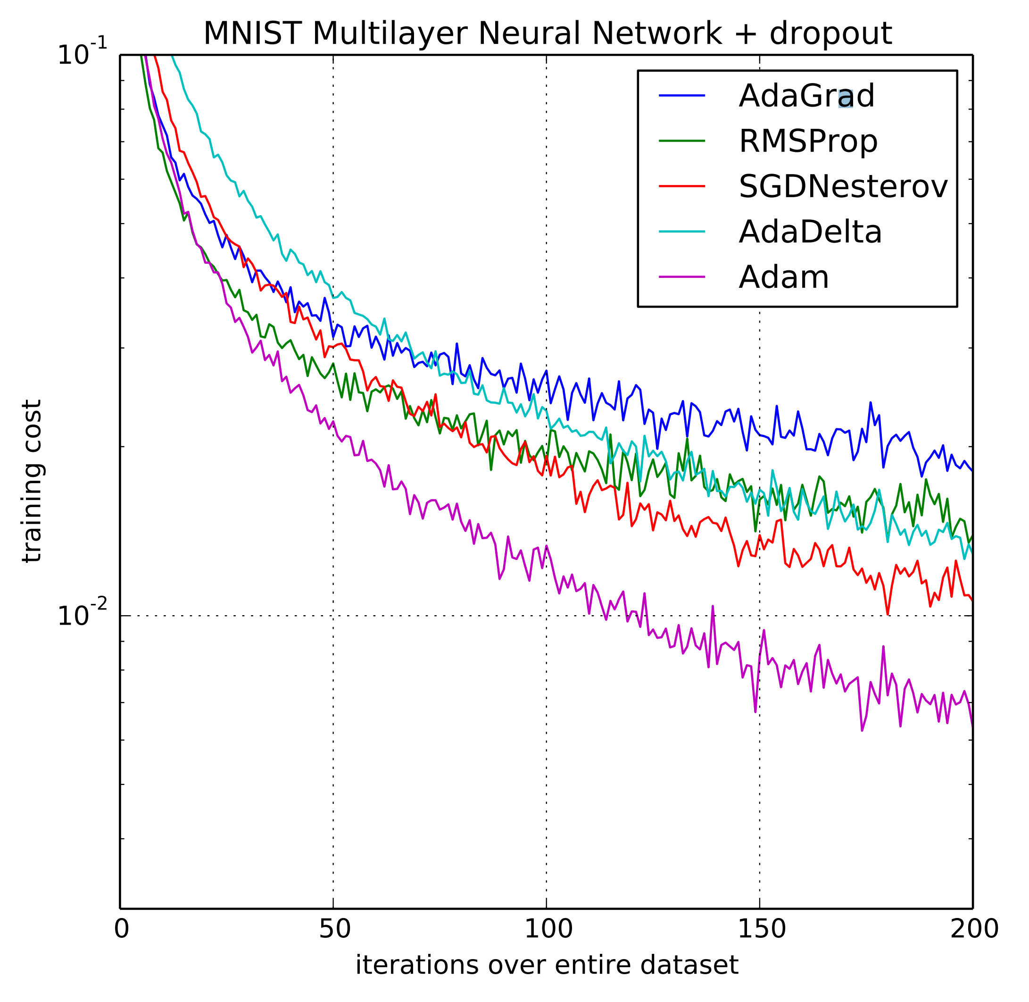
Adam (Adaptive Moment Estimation)
Network configuration:
Input layer: 28x28
2 hidden layers (1000 ReLUs each)
Output: 10 SoftMax
Cross-entropy loss
Figure from Kingma & Ba, 2015

